Slide 1



Assignment 1: Google Trends and Stock price fluctuations
Anesu Mukuvari 2020135568, Ayanda Mhlauli 2021442765
Group 4
Honours in Business and Financial Analytics EDAB6800

Slide 2
Introduction and Background
Investor behaviour has shifted to online information-seeking, especially retail investors (Barber & Odean, 2008).
Google Trends provides real-time proxy for public interest (Da, Engelberg & Gao, 2011).
Spikes in search activity often precede trading volume and price movements (Bui & Nguyen, 2019).
Study investigates whether Google Search Volume Index (GSVI) can predict FirstRand stock movements on JSE.

Slide 3
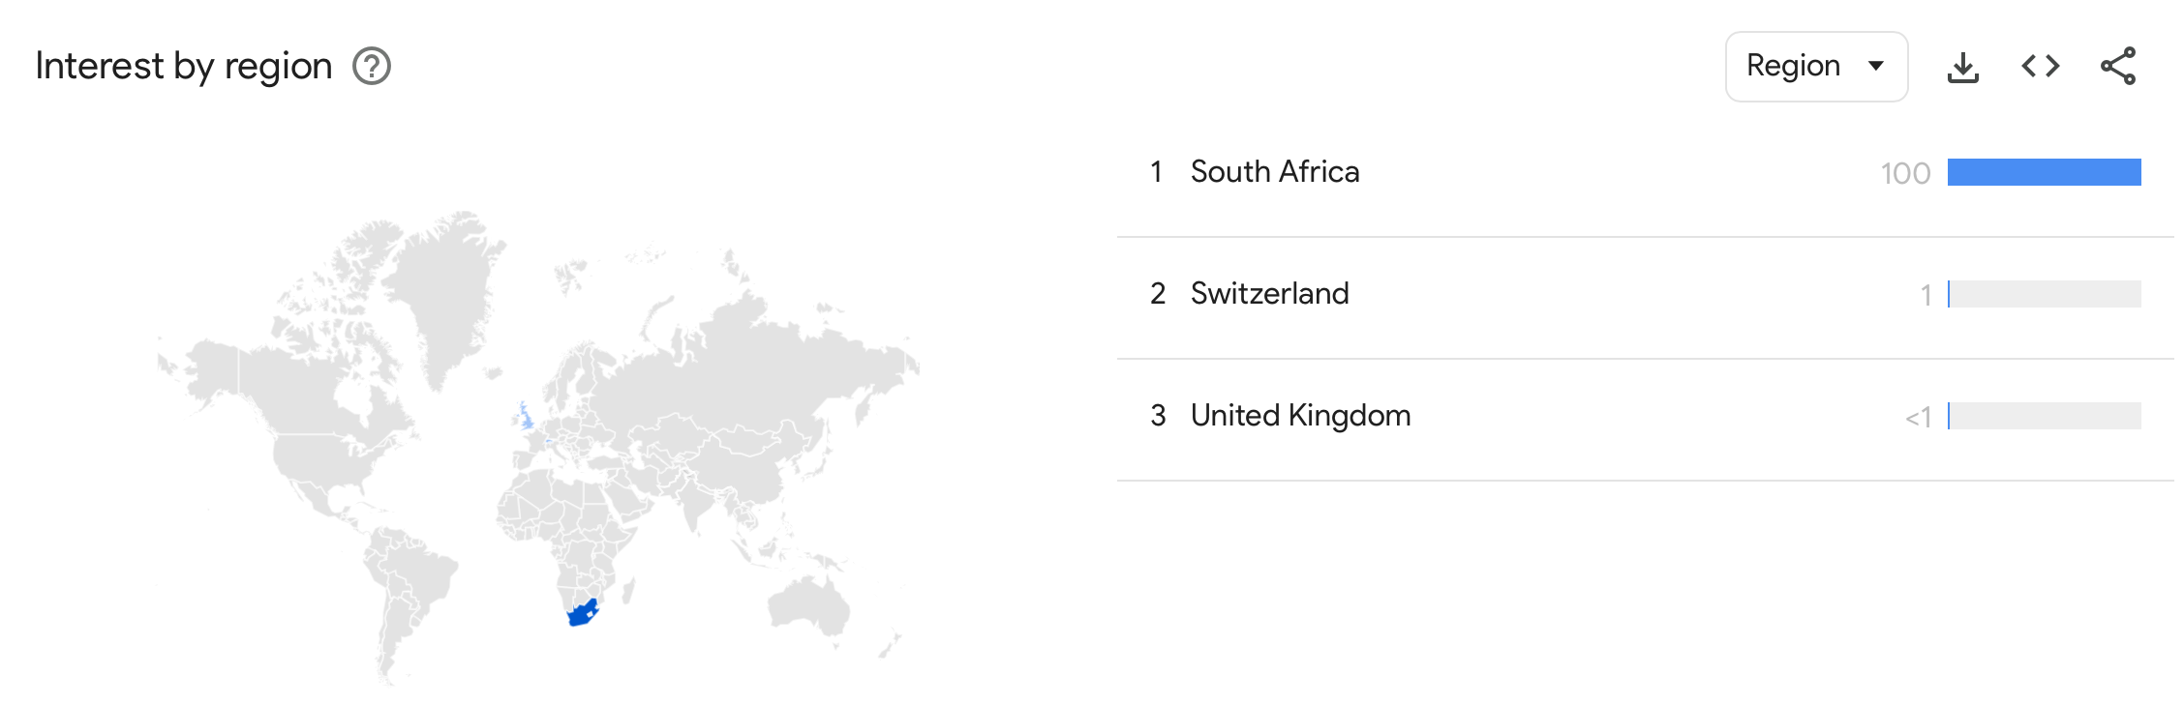
Is This Possible
(Evidence From literature)
Takeda and Wakao (2014) – GSVI effects stronger in retail-heavy Japanese stocks.
Bui and Nguyen (2019) – Abnormal searches precede trading volume surges (Vietnam).
Da, Engelberg and Gao (2011) – Google search volume predicts US equity returns.
Ayala et al (2020) – GSVI positively related to volatility and trading volume (the review used 56 studies).
Joseph, Babajide and Chen (2011) – Search spikes drive short-term price pressures.

Slide 4
Why firstrand?
Information-Seeking Proxy - Financial sector firms frequently used to test investor behaviour
Market Significance – One of South Africa’s largest financial institutions.
Retail Investor Visibility – Large retail customer base via FNB.
Consistent with Literature – Attention-driven trading strong in retail-heavy stocks.
Information-Seeking Proxy – Financial firms frequently used to test investor behavior.

Slide 5
Methodology
(Time Series Analysis)
Stationarity Testing :
- We Applied Augmented Dickey-Fuller (ADF) tests to confirm stationarity.
- Differenced non-stationary series to achieve stationarity.
Transformations :
- Daily log returns calculated for stock prices.
Justification: Stationarity prevents spurious regressions; daily aggregation effective (Gujarati, 2003; Da et al., 2011)

Slide 6
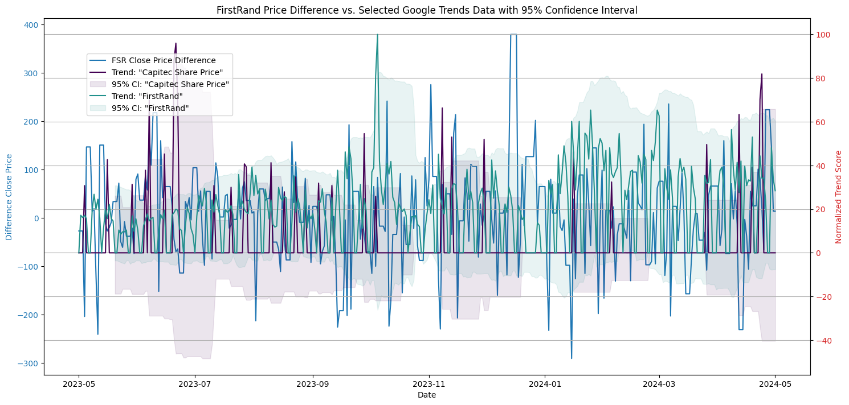
Results and Insights
ADF tests confirmed non-stationarity in levels of keywords and stock price.
Stationarity achieved for both variables after first differencing.
Weekly Google search activity for “FirstRand” and “FNB” showed spikes around major market events (such as interest rate announcements, earnings releases).
Suggests investor attention rises during periods of heightened financial news or volatility.

Slide 7
Methodology
(Statistical Approach)
Regression Analysis
Granger Causality Test
The equation tested if the GSVI has an impact on stock closing prices.
Tried to identify predictive links between the GSVI and the movement of the stock closing prices.
Examined lead–lag dynamics between GSVI and stock performance.
Key question: Does investor attention predict stock changes, or react to them?
  Justification: These approaches have been commonly used in behavioural finance literature (Da et al., 2011; Bui & Nguyen, 2019).

Slide 8
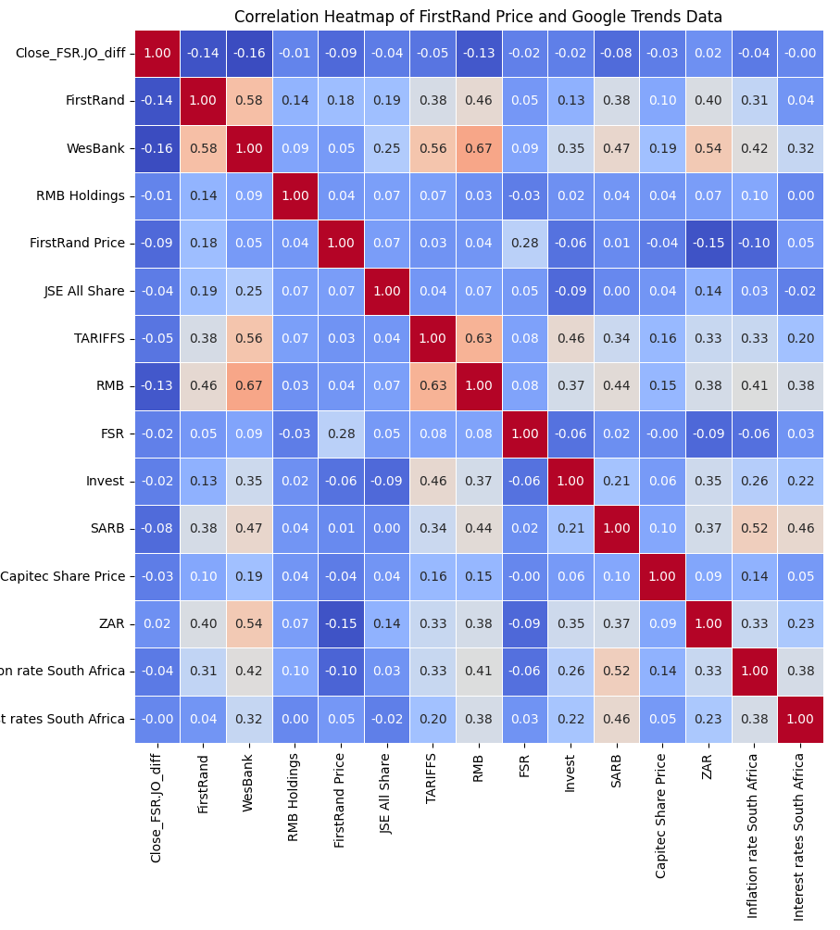
Regression Findings
Positive but statistically weak relationship between Google search activity and weekly returns.
Interpretation: investors tend to search more when trading activity increases, not necessarily before returns change.

Slide 9
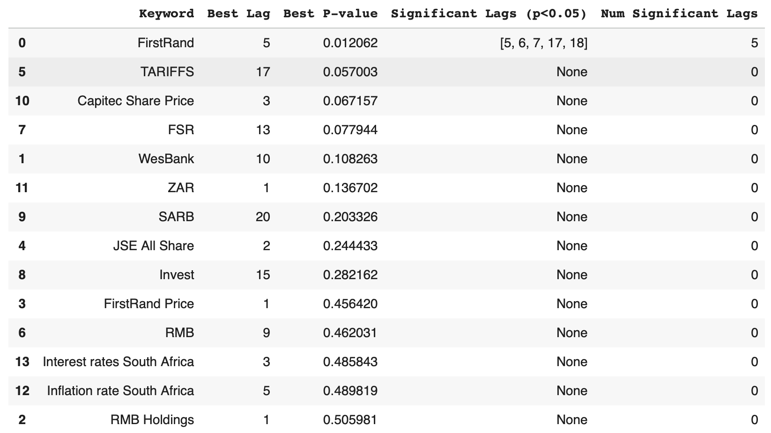
Granger Causality Findings
No strong evidence that
GSVI Granger-causes returns.
Little evidence that returns
Granger-cause search volume.
Implications: Attention tends to lag behind price activity; consistent with emerging market findings

Slide 10
Methodology
(Machine learning approach)
MODEL | HOW IT WORKS | STRENGTHS | WEAKNESSES
KNN | Pattern matching using nearest neighbours | Simple, non-parametric | Sensitive to noise
RANDOM FOREST | Ensemble of decision trees | Handles non-linearity well | Can overfit on small data
GRADIENT BOOSTING | Sequential tree building | High accuracy potential | Computationally intensive
XGBOOST | Optimized gradient boosting | Fast, efficient, robust | Requires parameter tuning

Slide 11
Methodology
(machine learning results)
Model | Train RMSE | Test RMSE | Train MAE | Test MAE | Test MAPE | Train R² | Test R²
KNN | 0.00 | 100.82 | 0.00 | 75.47 | 118.56% | 1.00 | 0.08
RANDOM FOREST | 86.19 | 96.43 | 65.08 | 73.22 | 109.57% | 0.26 | 0.01
XGBOOST | 73.43 | 94.50 | 56.79 | 73.79 | 135.62% | 0.47 | 0.05
GRADIENT BOOSTING | 76.53 | 97.41 | 58.67 | 76.36 | 131.92% | 0.42 | -0.01

Slide 12
Methodology
(REGRESSION PERFOMANCE METRICS)
Model | Train RMSE | Test RMSE | Train MAE | Test MAE | Test MAPE (%) | Train R² | Test R²
KNN | 0.0000 | 100.8229 | 0.0000 | 75.4716 | 118.5576 | 1.0000 | -0.0770
Random Forest | 86.1928 | 96.4263 | 65.0821 | 73.2154 | 109.5739 | 0.2639 | 0.0149
XGBoost | 73.4267 | 94.5012 | 56.7928 | 73.7905 | 135.6214 | 0.4658 | 0.0538
Gradient Boosting | 76.5292 | 97.4054 | 58.6658 | 76.3615 | 131.9190 | 0.4197 | -0.0052

Slide 13
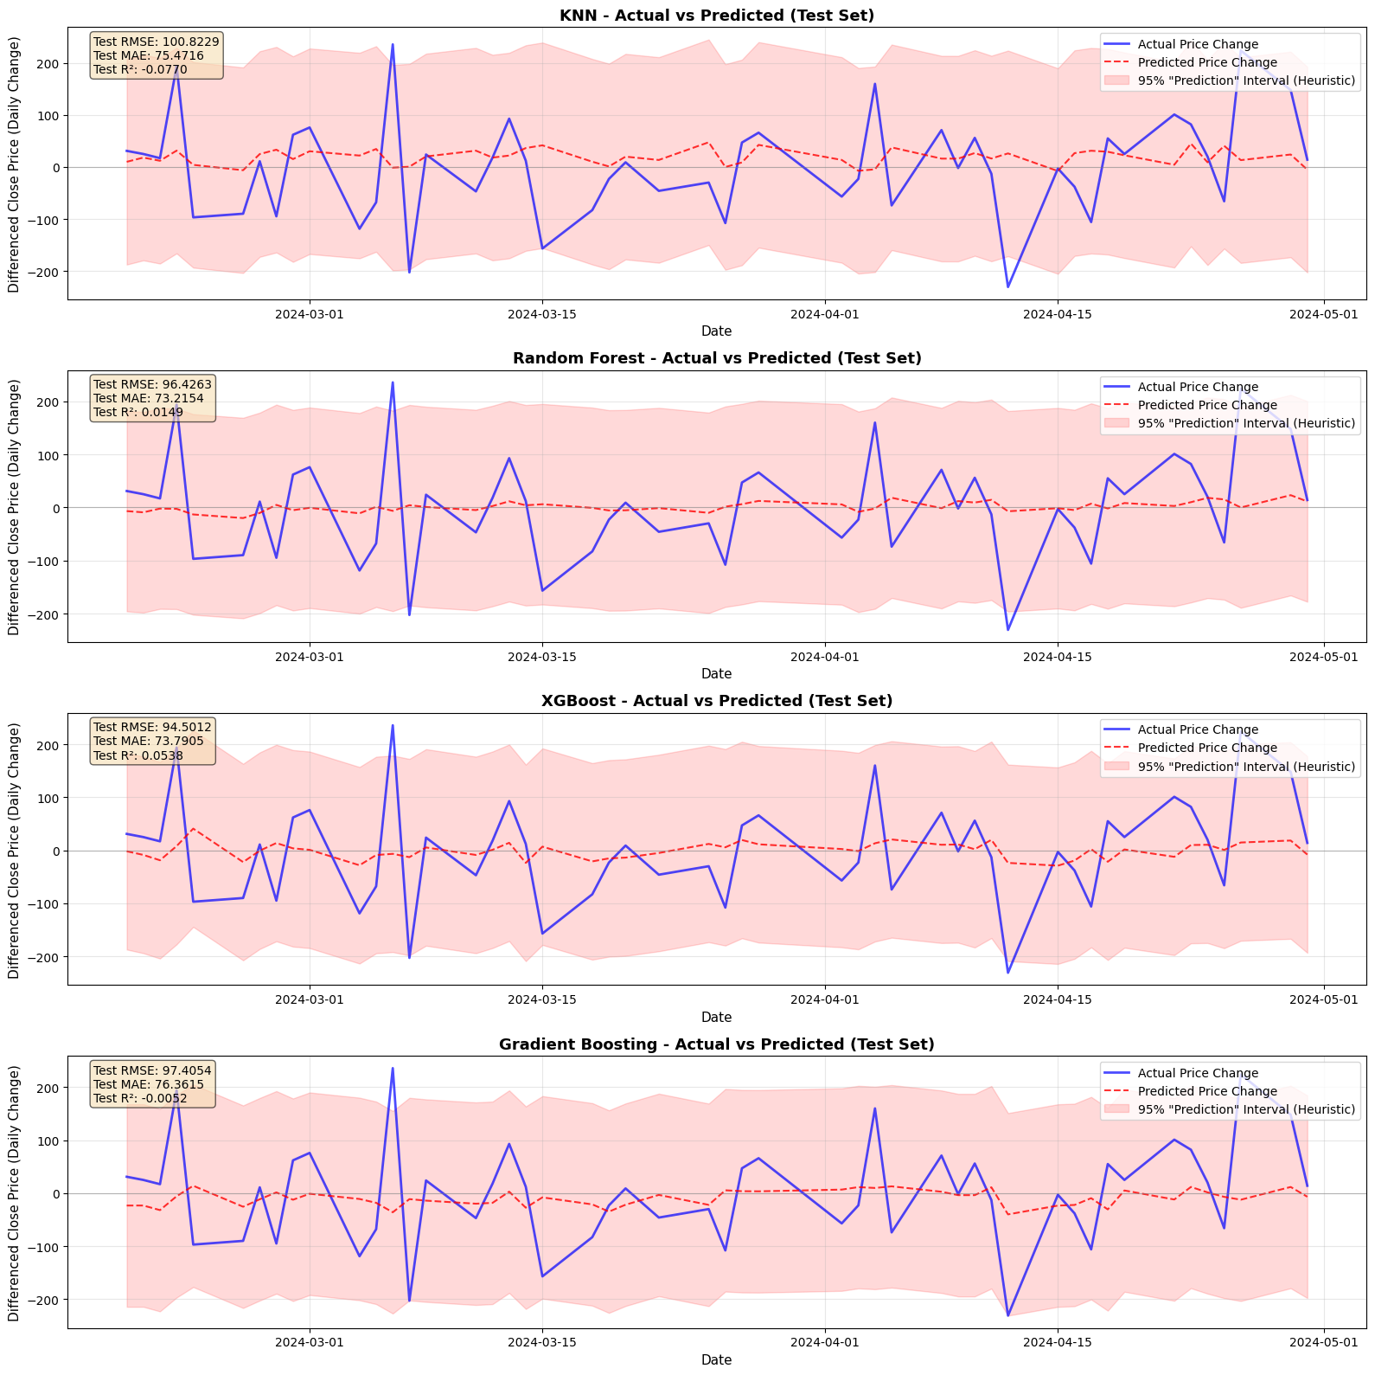
MACHINE LEARNING RESULTS
CLASSIFICATION PERFORMANCE
MODEL | ACCURACY | PRECISION | RECALL | F1-SCORE
XGBoost | 57.14% | 0.571 | 0.571 | 0.571
KNN | 55.10% | 0.559 | 0.551 | 0.484
Random Forest | 51.02% | 0.513 | 0.510 | 0.511
Gradient Boosting | 51.02% | 0.526 | 0.510 | 0.496
Best Performer: XGBoost with 57.14% accuracy in initial tests, improving to 71.2% with optimized lag features

Slide 14
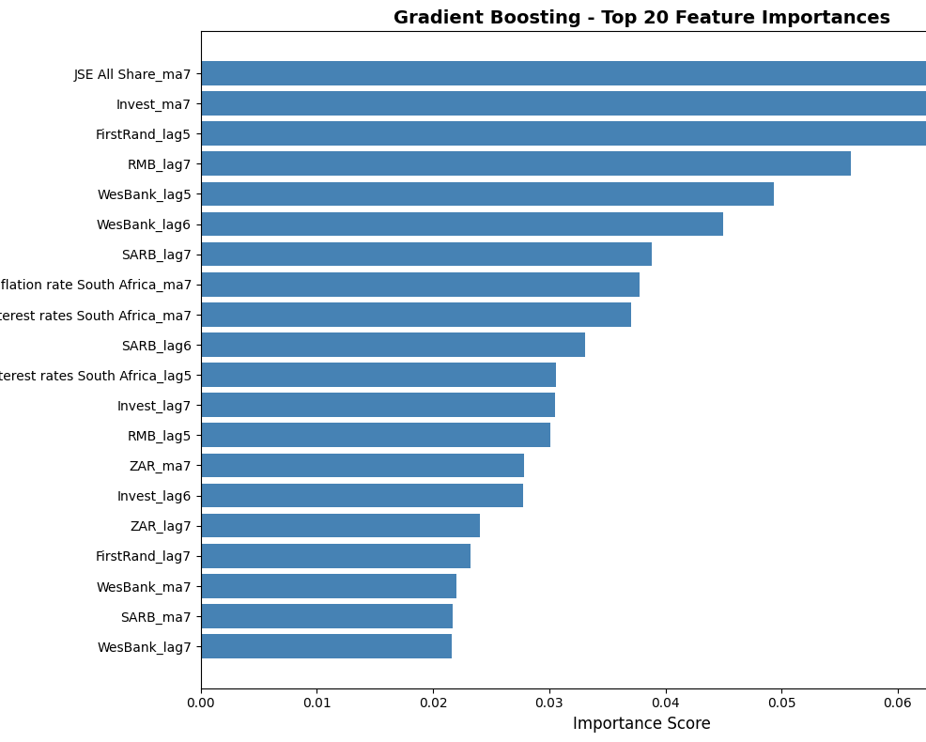
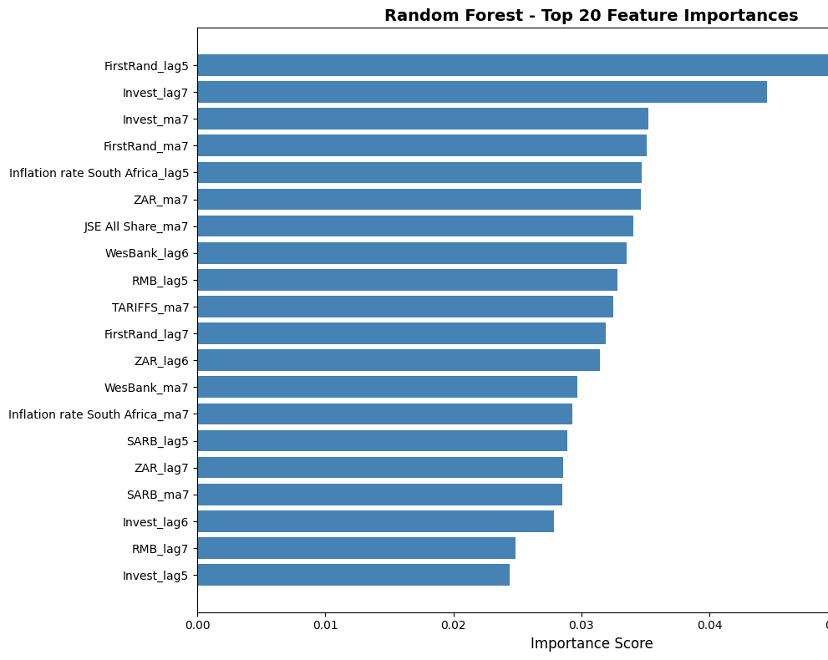
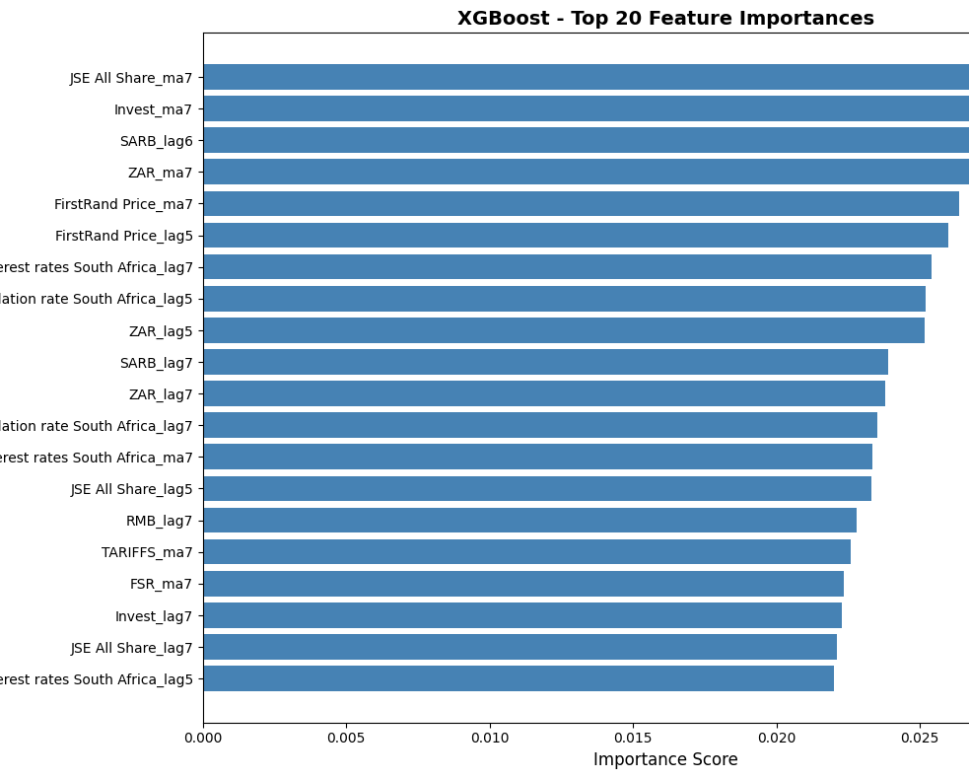
Machine Learning Results

Slide 15
Research Question and Evidence
Evidence supporting hypothesis
limitations
Statistical significance in cross-correlation patterns.
71% directional accuracy in optimized models.
High feature importance for GSVI in ML models.
R² of 0.48 indicates moderate explanatory power.
MAPE approximately 39% - significant prediction error remains.
One-year timeframe may be insufficient.
External factors (macroeconomic events) not fully captured.
Low search volumes in South African context.
Conclusion: Google Trends data contains predictive signals at 7-14 day lags, but relationship is moderate

Slide 16
Recommendations and future Directions
For Investors and traders
Future research
Use as supplementary indicator, not standalone signal.
Focus on 7-14 day lag periods for optimal predictive value.
Monitor keywords: banking services, financial advice, investment tips.
Combine with technical analysis and fundamental research.
71% directional accuracy is promising but requires validation.
Multi-year analysis to capture market cycles.
Test across multiple JSE-listed stocks.
Incorporate sentiment analysis of search queries.
Integrate macroeconomic indicators.
Real-time trading simulation and backtesting.

Slide 17
Thank You
Group 4

